Slide 1
P2P LAN Game ColorFight

Slide 2
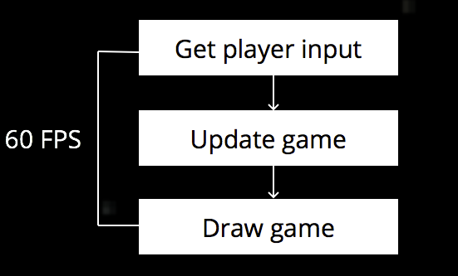
How does a game work?
A game works on ‘Update → Draw → Repeat’ principle.

Slide 3
The Game
ColorFight is a p2p multiplayer LAN game.
Each player is represented by a circle that exists in one of the four possible states.
Each state has a set of unique characteristics.
Orange: Initial state, smallest, fastest, no rights.
Blue: Bigger, slower, can collect shields.
Green: Bigger, more slower, can shoot and collect shields and fireball.
White: Biggest, slowest, immune to bullets.
A player can upgrade or downgrade to any state given a minimum score.
The goal of the game is to survive and destroy all opponent players.

Slide 4
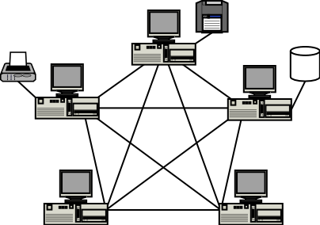
Multiplayer Network
For p2p connection, each player behaves as a server and also as a client.
Each client requires to know IP address and port number of the serving peer to receive its data.

Slide 5
Our Approach
A temporary master node is chosen.
A TCP connection is established between every client and the master node.
It is required for each client to know the IP address of the master node. The default port is 8000.
Once N-1 TCP connections are established, the master node sends following space separated string to each client. ID, Num of players, All peer IPs including masterIP
In above string, ID is determined by master for each node. Master ID is 1.
The TCP connection is closed after the above string is sent to each client.

Slide 6
Our Approach (contd.)
Now, each peer has all IP addresses. Each peer knows that every node will transmit its player data on port 8000.
Each player starts its own UDP server thread on port 8000.
After a delay, it starts its N-1 client threads.
For getting updated info of a peer, the node will request that peer with “OK” string. When that node receives the request, it transmits its player data to that node using the port and IP information of the client node.
Thus, each peer receives other peers’ player data and it updates the information in its local machine.

Slide 7
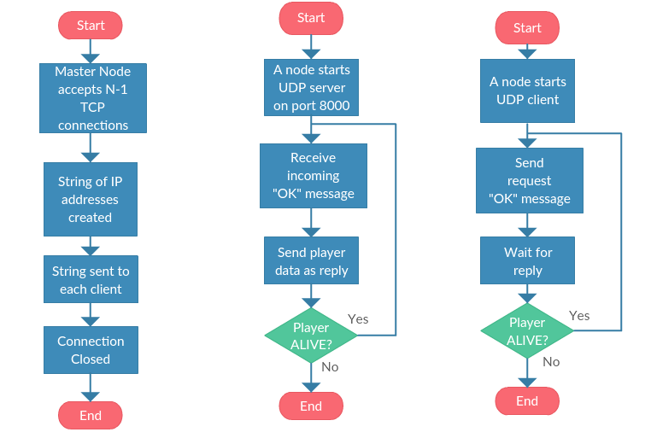
Flow Chart

Slide 8
Send String Format
Following is the format of the send string:
Alive, p.x, p.y, p.color, bullet.x, bullet.y, bulletActive, beadI, beadI.x, beadI.y, beadI.color, powerI, powerI.x, powerI.y, powerType, p.score, p.shield, p.fireCap, bulletKillID, fireBallKillID
Common Resource:
In this game, beads and powerups (shield and fireball) are a common resource. If a player collects any resource, a new resource is spawned by that machine. This information needs to be sent to every other peer. It is embedded as part of the send string.

Slide 9
References:
http://www.pcc-services.com/images/peertopeer.png
http://dreamingechoes.github.io/images/2015-12-02-become-a-videogame-developer-master-with-gosu-and-ruby/game_loop.png
http://www.gametutorial.net/

